Slide 1
Money Printer
Keeno Glanville

Slide 2
Scenario
You are a 37-year-old bond trader in a major investment firm. Your investment portfolio, largely holding high return equities is valued today at $6.2 M. You have just read Jamie Dimon's financial hurricane warning and decided to rebalance your portfolio.

Slide 3
Assumptions
September 2021, Jamie Dimon, the CEO of JPMorgan Chase, warned of a potential "financial hurricane" due to various economic factors, including inflation, fiscal and monetary policy, and geopolitical tensions. He advised that businesses and policymakers should remain vigilant and prepared for potential economic challenges and uncertainties.
We will need to diversify the high yield equities portfolio
We need to add more bonds since I am a bond trader and know the tolerance
Need to stress diversification as to not get to heavily weighted on one medium

Slide 4
Portfolio Allocation
Asset | Ticker | Type | Subtype | Date | Price | Units | Amount
Apple Inc. | AAPL | Equity | Technology | 12-Sep-23 | $176.30 | 648 | $114,242
Amazon.com Inc. | AMZN | Equity | E-commerce | 12-Sep-23 | $142.32 | 1,000 | $142,320
Microsoft Corporation | MSFT | Equity | Technology | 12-Sep-23 | $331.77 | 500 | $165,885
Alphabet Inc. | GOOGL | Equity | Technology | 12-Sep-23 | $135.19 | 800 | $108,152
META | META | Equity | Technology | 12-Sep-23 | $324.40 | 500 | $162,200
Tesla, Inc. | TSLA | Equity | Automotive | 12-Sep-23 | $250.10 | 1,599 | $399,910
NVIDIA Corporation | NVDA | Equity | Technology | 12-Sep-23 | $447.38 | 850 | $380,273
Advanced Micro Devices | AMD | Equity | Technology | 12-Sep-23 | $104.20 | 1,208 | $125,874
JPMorgan Chase & Co. | JPM | Equity | Financial Services | 12-Sep-23 | $146.34 | 995 | $145,608
Johnson & Johnson | JNJ | Equity | Healthcare | 12-Sep-23 | $163.93 | 886 | $145,242
Visa Inc. | V | Equity | Financial Services | 12-Sep-23 | $247.30 | 588 | $145,412
Procter & Gamble Company | PG | Equity | Consumer Goods | 12-Sep-23 | $155.15 | 938 | $145,531
Johnson Controls International plc | JCI | Equity | Industrial | 12-Sep-23 | $56.66 | 1,577 | $89,353
General Electric Company | GE | Equity | Industrial | 12-Sep-23 | $114.00 | 1,279 | $145,806
Coca-Cola Company | KO | Equity | Consumer Goods | 12-Sep-23 | $57.84 | 1,521 | $87,975
Verizon Communications Inc. | VZ | Equity | Telecommunications | 12-Sep-23 | $34.18 | 4,262 | $145,675
Boeing Co. | BA | Equity | Industrial | 12-Sep-23 | $210.65 | 690 | $145,349
AT&T Inc. | T | Equity | Telecommunications | 12-Sep-23 | $14.19 | 1,025 | $14,545
Pfizer Inc. | PFE | Equity | Healthcare | 12-Sep-23 | $34.15 | 1,025 | $35,004
Netflix, Inc. | NFLX | Equity | Entertainment | 12-Sep-23 | $434.69 | 335 | $145,621
Alibaba Group Holding Limited | BABA | Equity | E-commerce | 12-Sep-23 | $88.19 | 1,650 | $145,514
Intel Corporation | INTC | Equity | Technology | 12-Sep-23 | $38.65 | 1,770 | $68,411
Walt Disney Company | DIS | Equity | Entertainment | 12-Sep-23 | $84.67 | 1,720 | $145,632
Exxon Mobil Corporation | XOM | Equity | Energy | 12-Sep-23 | $115.34 | 1,262 | $145,559
Ford Motor Company | F | Equity | Automotive | 12-Sep-23 | $12.23 | 1,209 | $14,786
Goldman Sachs Group, Inc. | GS | Equity | Financial Services | 12-Sep-23 | $324.01 | 450 | $145,805
Home Depot, Inc. | HD | Equity | Retail | 12-Sep-23 | $326.83 | 445 | $145,439
IBM (International Business Machines Corporation) | IBM | Equity | Technology | 12-Sep-23 | $146.30 | 995 | $145,569
Starbucks Corporation | SBUX | Equity | Consumer Goods | 12-Sep-23 | $95.50 | 527 | $50,329
Cisco Systems, Inc. | CSCO | Equity | Technology | 12-Sep-23 | $56.65 | 582 | $32,970
iShares iBoxx $ Investment Grade Corporate Bond ETF | LQD | Bond | Investment Grade Corporate Bonds | 12-Sep-23 | $104.53 | 1,480 | $154,704
iShares iBoxx $ High Yield Corporate Bond ETF | HYG | Bond | High Yield Corporate Bonds | 12-Sep-23 | $74.56 | 2,076 | $154,787
iShares 7-10 Year Treasury Bond ETF | IEF | Bond | Intermediate-Term Treasury Bond ETF | 12-Sep-23 | $93.24 | 1,660 | $154,778
Vanguard Total Bond Market ETF | BND | Bond | Total Bond Market | 12-Sep-23 | $70.93 | 2,182 | $154,769
iShares 1-3 Year Treasury Bond ETF | SHY | Bond | Short-Term Treasury Bond ETF | 12-Sep-23 | $80.91 | 1,910 | $154,538
Vanguard Short-Term Corporate Bond ETF | VCSH | Bond | Short-Term Corporate Bond ETF | 12-Sep-23 | $75.35 | 2,060 | $155,221
Invesco Senior Loan ETF | BKLN | Bond | Senior Loan ETF | 12-Sep-23 | $21.20 | 7,312 | $155,014
iShares TIPS Bond ETF | TIP | Bond | Treasury Inflation-Protected Securities (TIPS) Bond ETF | 12-Sep-23 | $105.38 | 1,469 | $154,803
Schwab U.S. TIPS ETF | SCHP | Bond | Treasury Inflation-Protected Securities (TIPS) Bond ETF | 12-Sep-23 | $51.31 | 3,014 | $154,648
iShares 20+ Year Treasury Bond ETF | TLT | Bond | Long-Term Treasury Bond ETF | 12-Sep-23 | $93.89 | 1,653 | $155,200
Cash (Min 620k) | Cash | Cash | Cash | 12-Sep-23 |  |  | $621,547
Total Bonds (Max 1.56mil) | Total Bonds | Total Bonds |  |  |  |  | $1,548,464
Total Equities(Max 4.03mil) | Total Equities | Total Equities |  |  |  |  | $4,029,989
Total Portfolio(Max 6.2mil) | Total Portfolio | Total Portfolio |  |  |  |  | $6,200,000

Slide 5
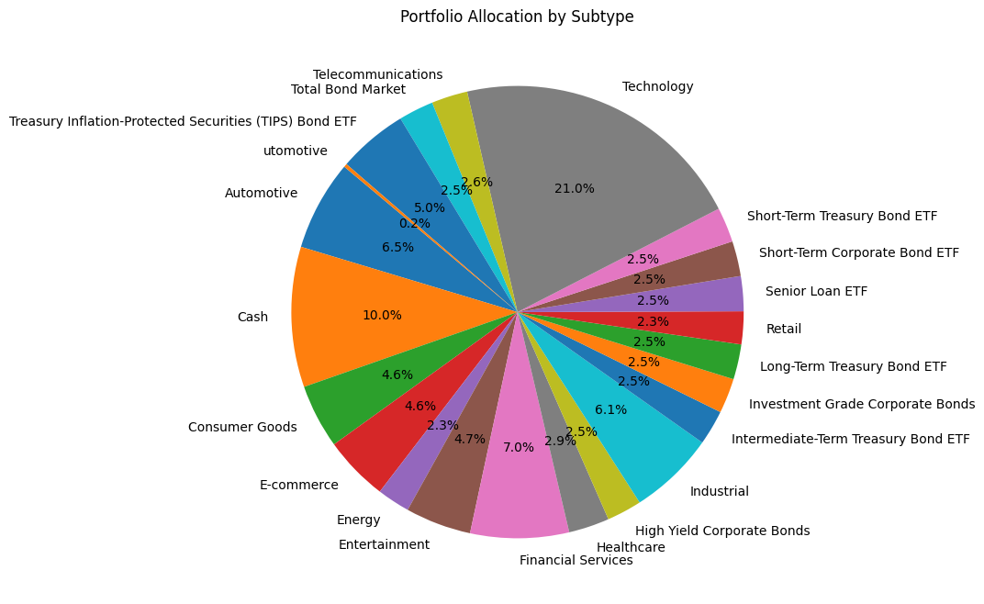
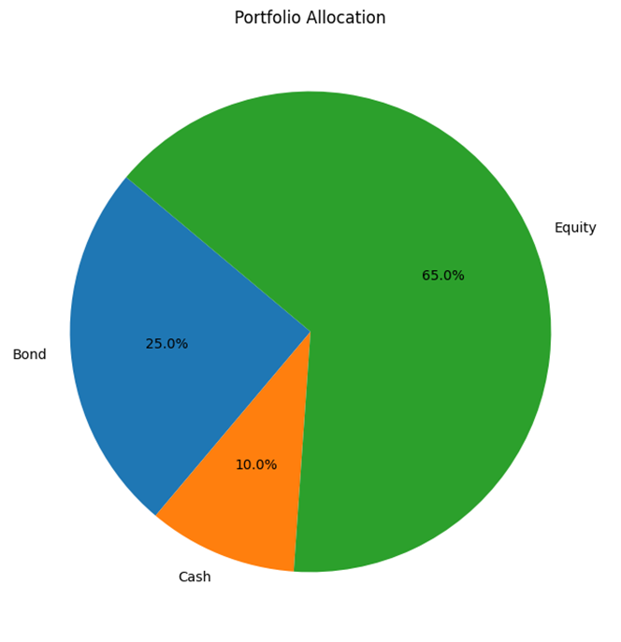
Title and Content Layout with Chart

Slide 6
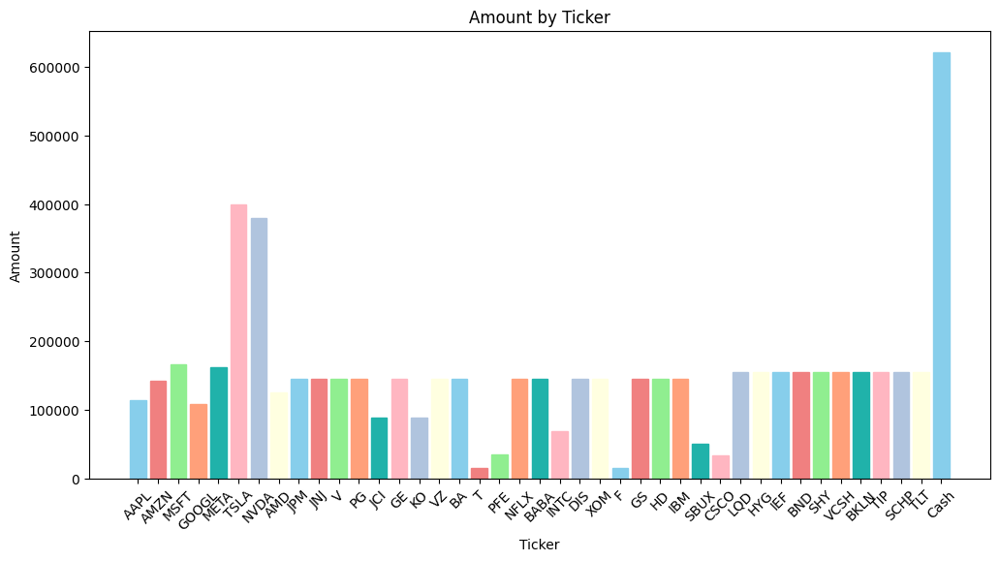
Ticker bar visualization

Slide 7
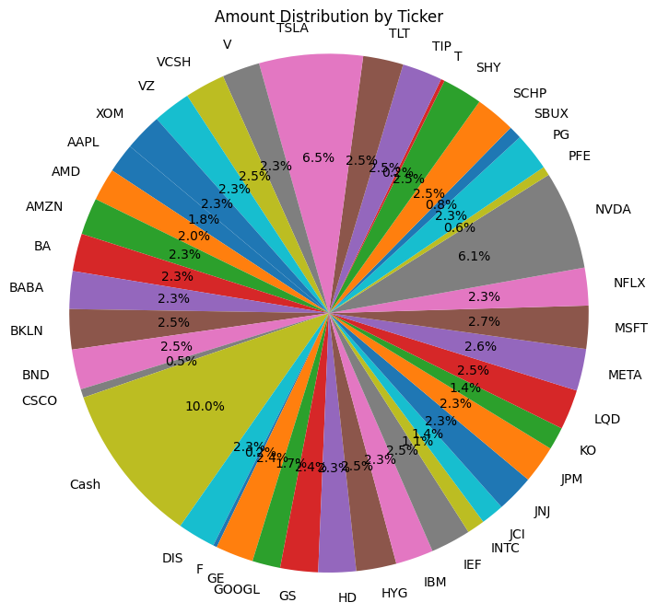
Ticker Pie Chart

Slide 8
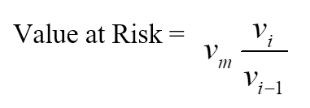
What is Value at Risk?
Value at Risk (VaR) is a financial metric that estimates the risk of an investment, it estimates how much a portfolio or investment might lose given normal conditions in a time period
One of the simplest methods for calculating VaR is the Historical Method
vi is the number of variables on day i
m is the number of days from which historical data is taken

Slide 9
VaR Results
VaR(95.0) (Value at Risk at 95% confidence level) gives you an estimate of the maximum potential loss over a specified time frame. In this case, it suggests a loss of approximately 1.8%, 3.7%, 1.8%, and 2.7% for different instances of your portfolio.
CVaR(95.0) (Conditional Value at Risk at 95% confidence level) is a measure of the expected loss given that the loss exceeds the VaR. The expected loss can be as much as 2.4%, 2.3%, and 2.9% for your portfolio.
CDaR(95.0) (Conditional Drawdown at Risk at 95% confidence level) is an estimate of the potential drawdown or decline in the portfolio over a specified time frame. It indicates a significant drawdown of around 24% in one instance and 67% in another.
Type | VaR | CVaR | CDaR
Historic | -0.018029 | -0.024314 | -0.240734
Parametric | -0.037458 | NaN | -0.240734
Monte Carlo | -0.018728 | -0.023443 | -0.240734
Monte Carlo (Stressed) | -0.027205 | -0.029711 | -0.671511

Slide 10
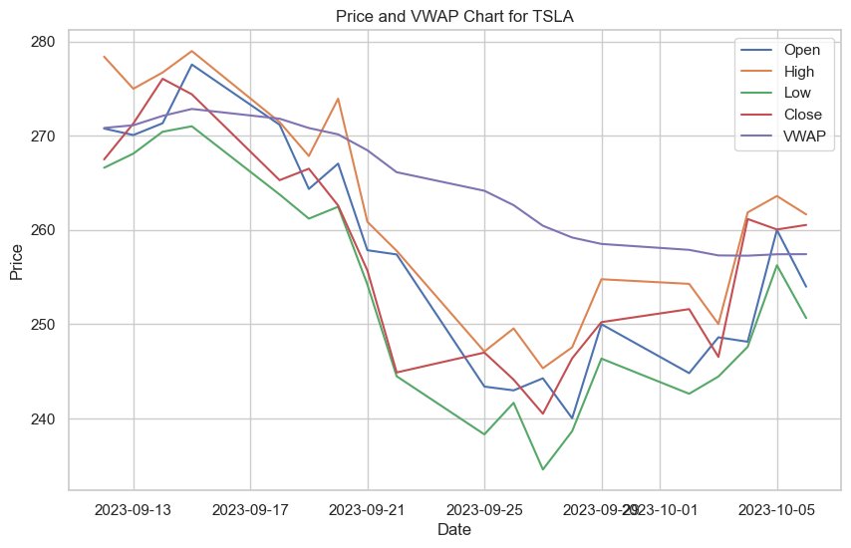
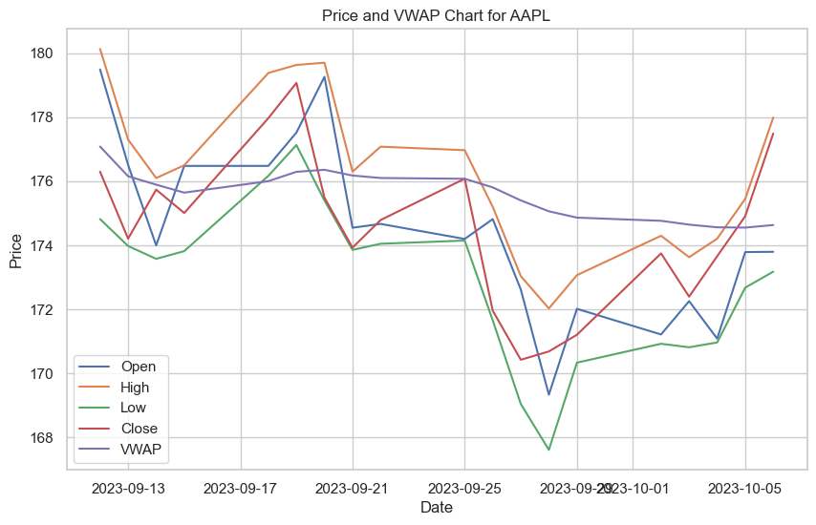
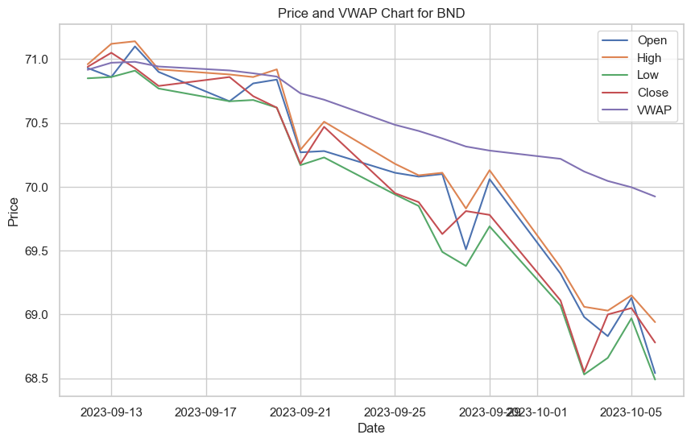
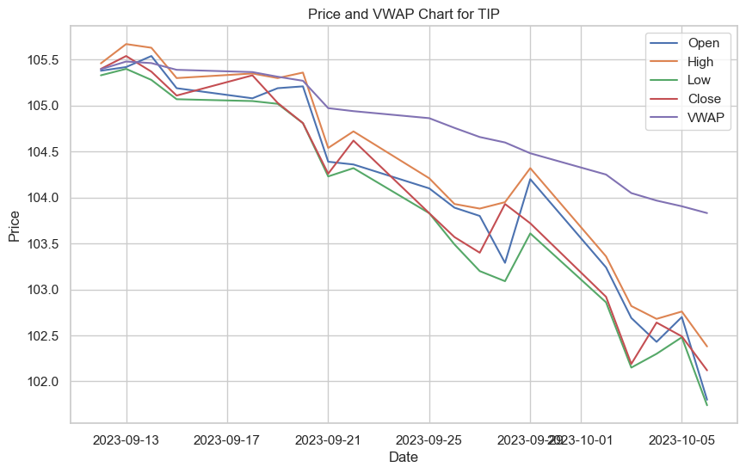
Volume Weighted Average Price (VWAP)

Slide 11
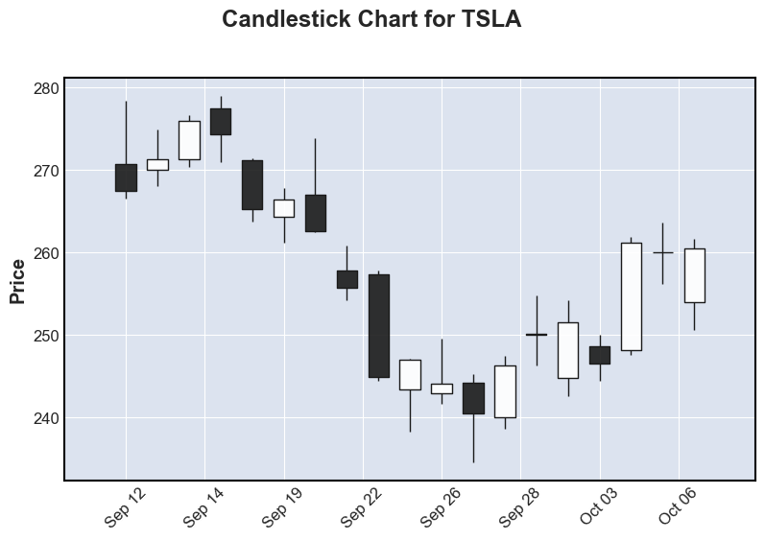
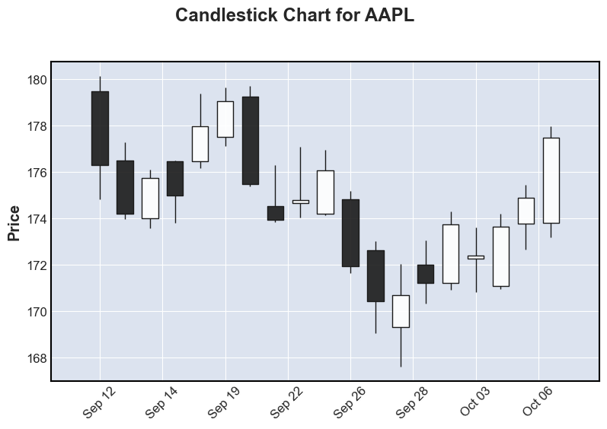
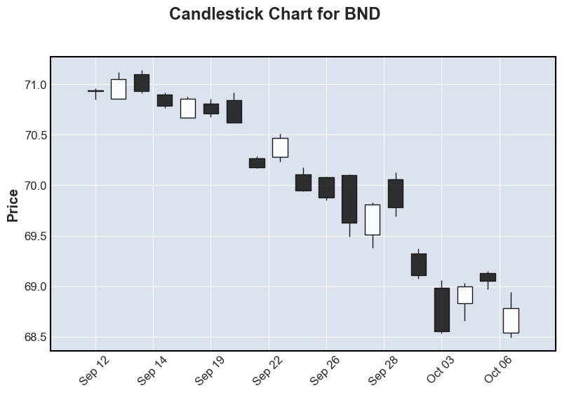
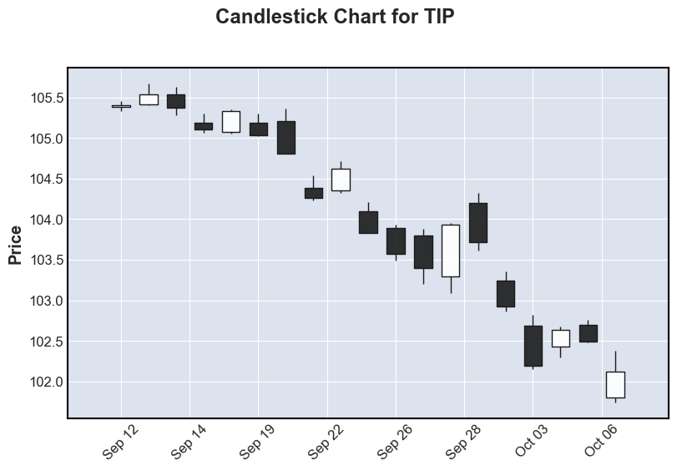

Slide 12
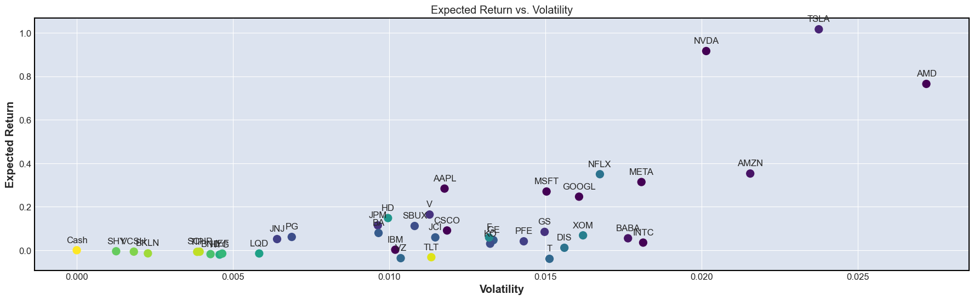
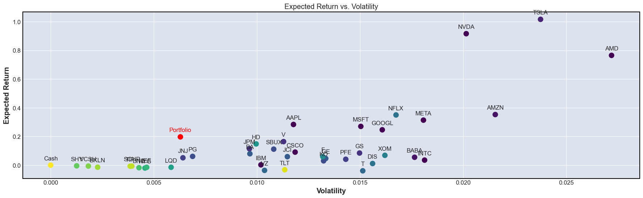
Expected Returns vs Volatility

Slide 13
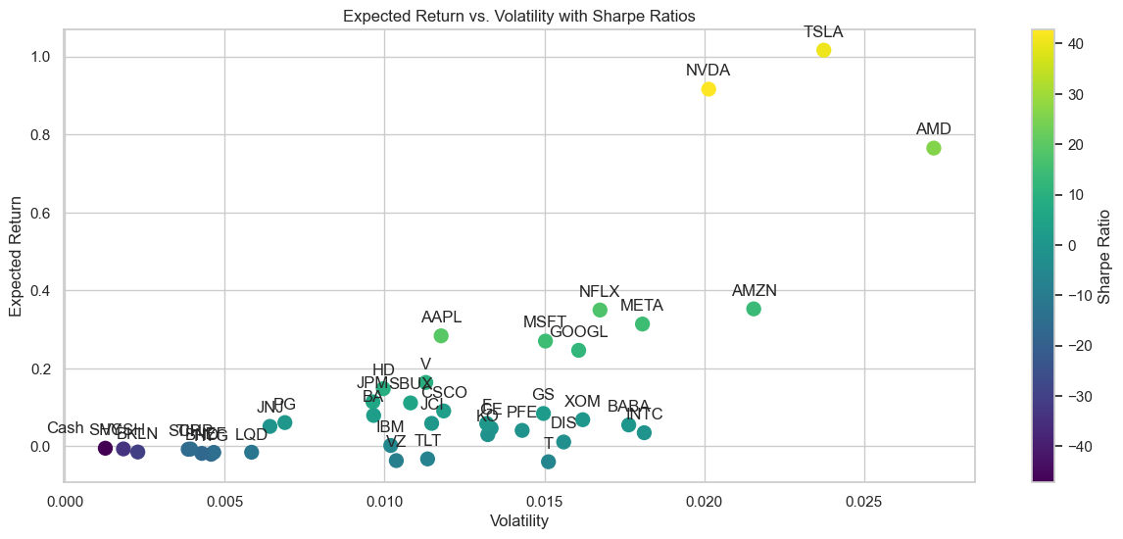
Sharpe Ratio The Sharpe Ratio is a measure of risk-adjusted return, quantifying the excess return generated by an investment or portfolio per unit of risk taken. A positive Sharpe Ratio indicates that the investment or portfolio is delivering a return higher than the risk-free rate for each unit of risk incurred, making it an attractive choice. Conversely, a negative Sharpe Ratio suggests that the investment's return is insufficient for the level of risk taken, making it less desirable than a risk-free investment.

Slide 14
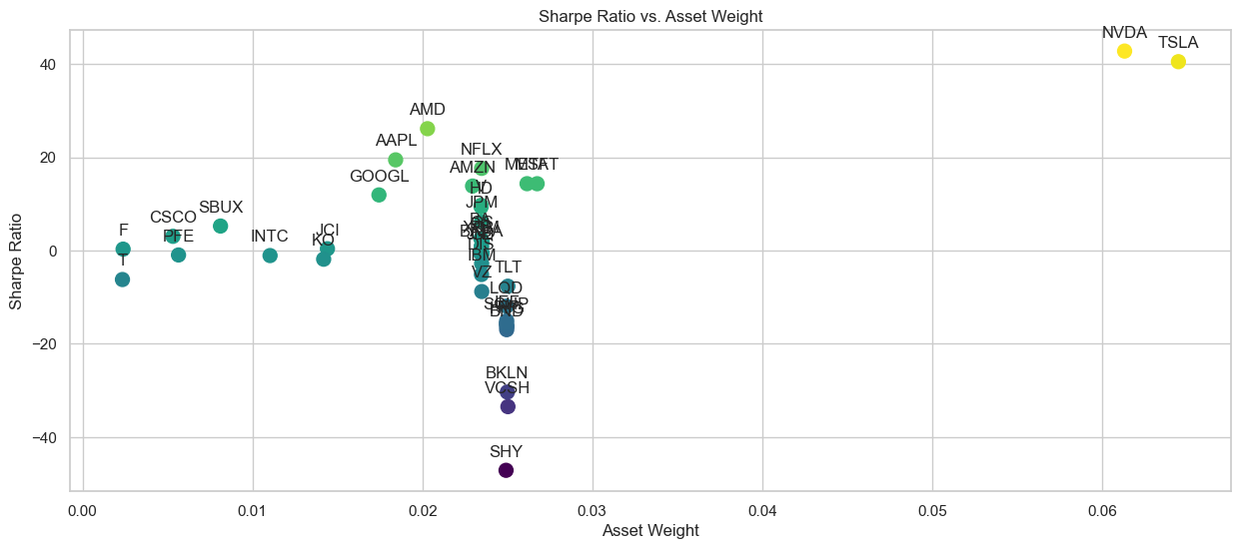
Sharpe Ratio vs Asset Weight

Slide 15
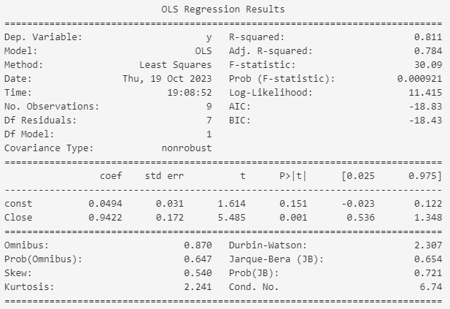
Alpha benchmarked against the S&P500
Alpha value of 0.1043 meaning we outperformed the SPY by 10.43% in the portfolio

Slide 16
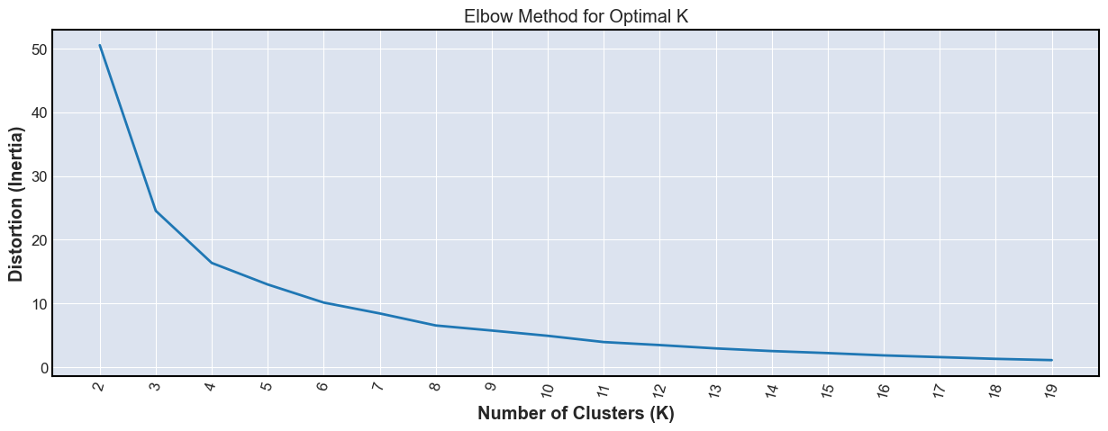
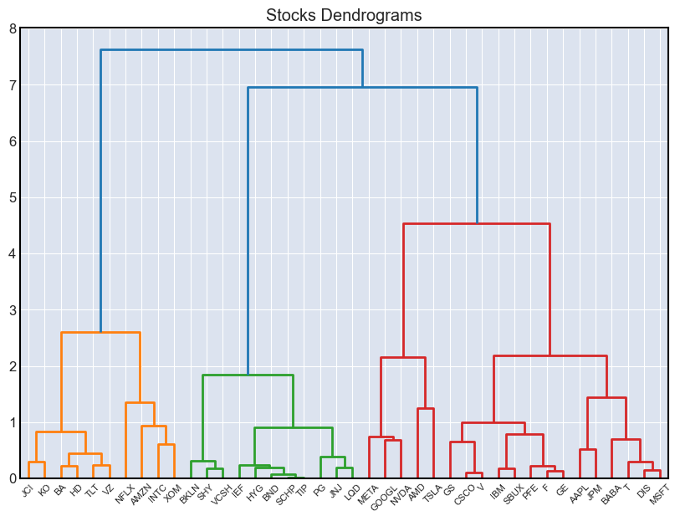
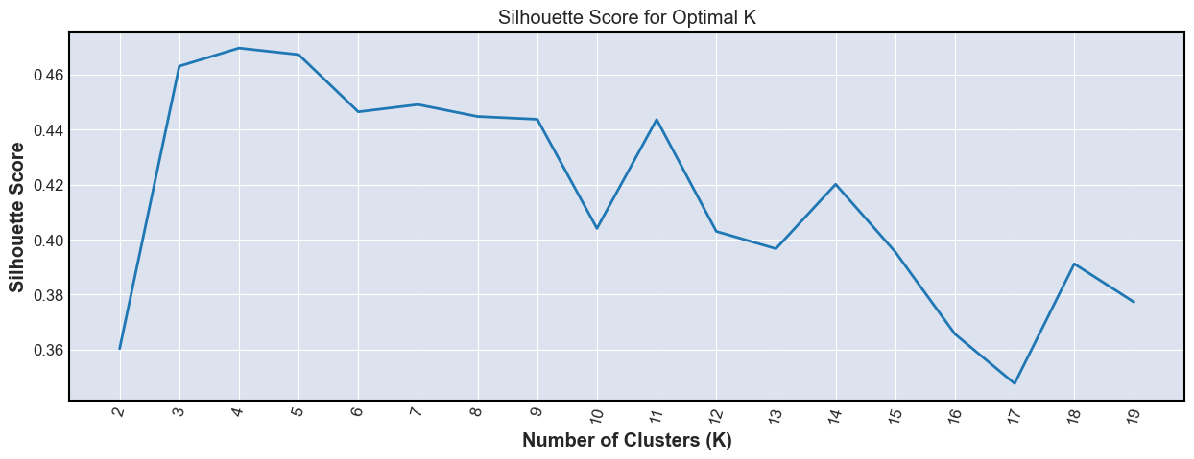
Clustering
The Silhouette Score and Elbow Method serve as valuable tools in determining the optimal number of clusters in KMeans clustering. The Silhouette Score quantifies the cohesion and separation of clusters, with a higher score indicating well-defined clusters. On the other hand, the Elbow Method identifies the point of diminishing returns in distortion reduction, signaling the optimal K. Choosing between these methods depends on the dataset characteristics; Silhouette Score suits well-separated, similarly dense clusters, while the Elbow Method is effective for compact, distinct clusters. A comprehensive approach involves considering results from both techniques and aligning the optimal K for a more robust clustering solution.

Slide 17
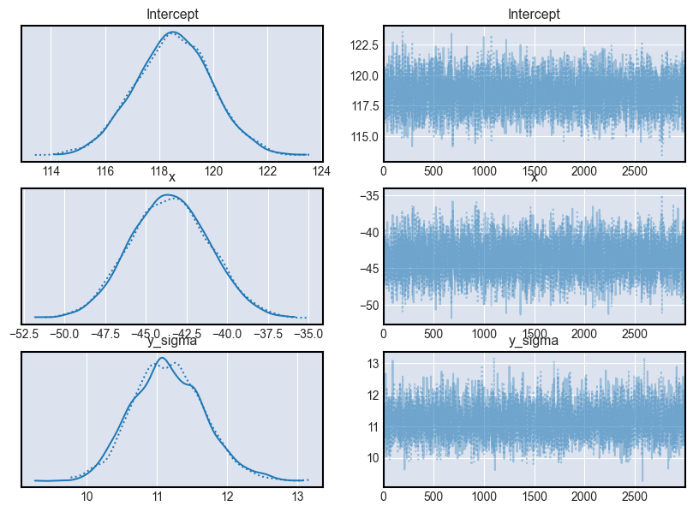
Bayes Volatility Forecast
The scatter plot method provides a visual snapshot of the relationship between expected return and volatility in a portfolio, offering a quick and intuitive overview. It is particularly useful for initial exploration and communication. On the other hand, Bayesian volatility forecasting, involving the use of statistical models, captures underlying relationships explicitly, providing uncertainty estimates through the posterior distribution. This method is advantageous for a more rigorous and quantitative analysis, especially when detailed insights into the statistical nature of the data are essential.

Slide 18
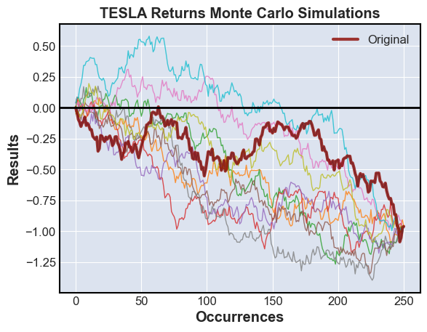
Monte Carlo Simulation
The estimated option prices from the Monte Carlo simulations suggest a positive value for the European Call option at approximately $69.76, indicating a potential profit if the option is exercised. However, the European Put option shows a negative value of approximately -$7434.13, suggesting a substantial expected loss if the option is exercised. These results highlight the inherent risk and speculative nature of financial options, emphasizing the importance of careful consideration and risk management in option trading strategies.

Slide 19
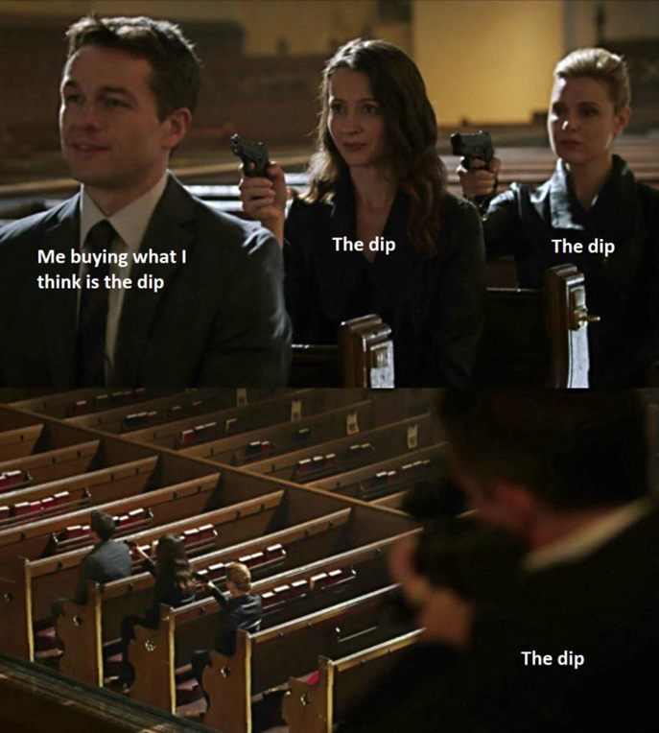
Conclusion
Hedge against the downside. Buy the dip!
Incorporate some reverse Bond ETFs to accommodate for the bond declines.
This could help bolster our returns while in the downturn of the market

